Slide 1
Creating the List Page

Slide 2

Overview
Hello MVC
Creating the model and the repository
Creating the controller
Adding the view
Styling the view

Slide 3
Hello MVC
Notes:
Coming up

Slide 4

The MVC in ASP.NET Core MVC
Model-View-Controller
Architectural pattern
Separation of concerns
Promotes testability and maintainability
Notes:
MVC is a framework taken from the MVC pattern

Slide 5
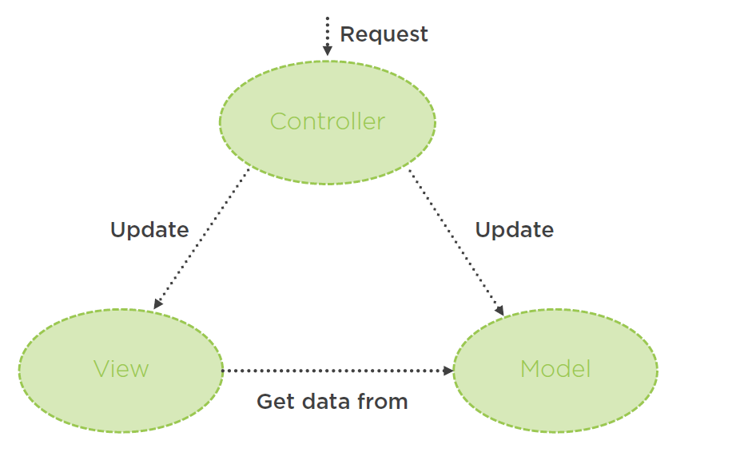
The MVC in ASP.NET Core MVC
Notes:
Coming up

Slide 6
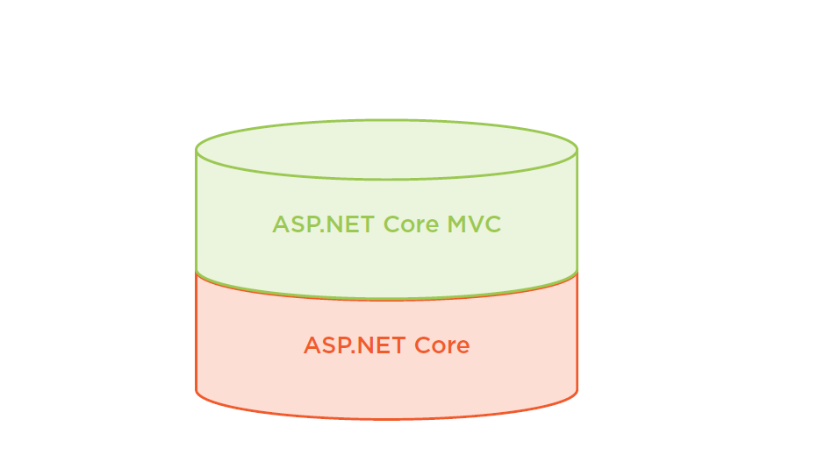
The MVC in ASP.NET Core MVC
Notes:
Coming up

Slide 7
Creating the Model and the Repository
Notes:
Coming up

Slide 8

The Model
Domain data + logic to manage data
Simple API
Hides details of managing the data

Slide 9
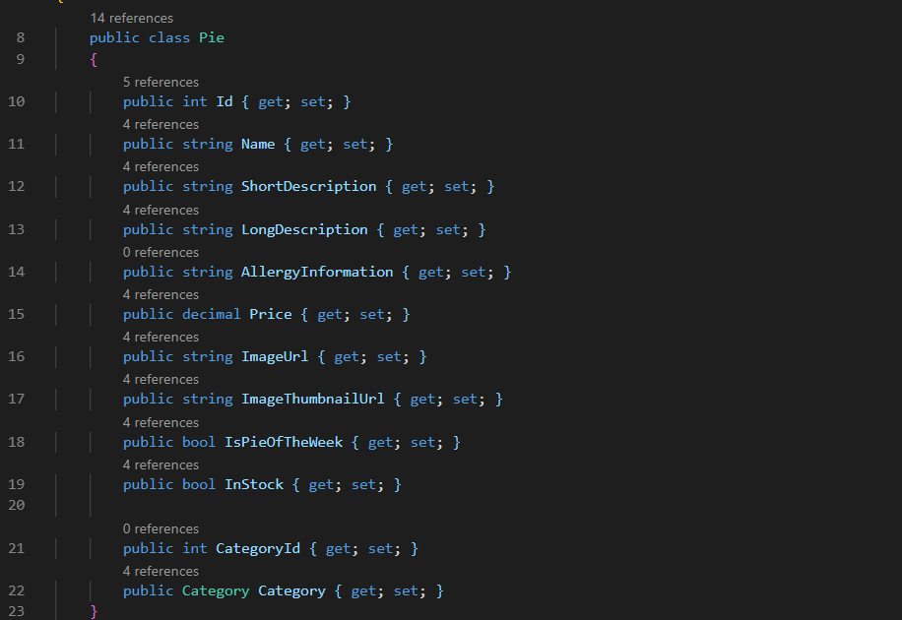
Sample Model Class
Notes:
Coming up

Slide 10
The repository allows our code to use objects without knowing how they are persisted

Slide 11
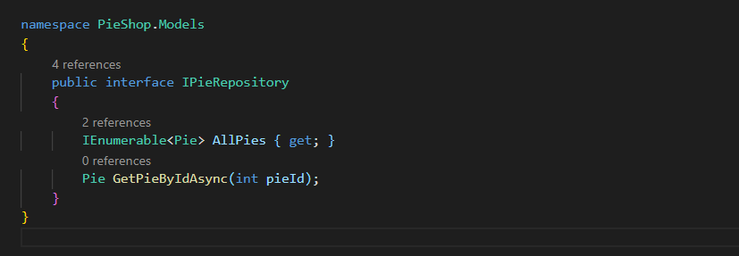
Repository Interface
Notes:
Coming up

Slide 12
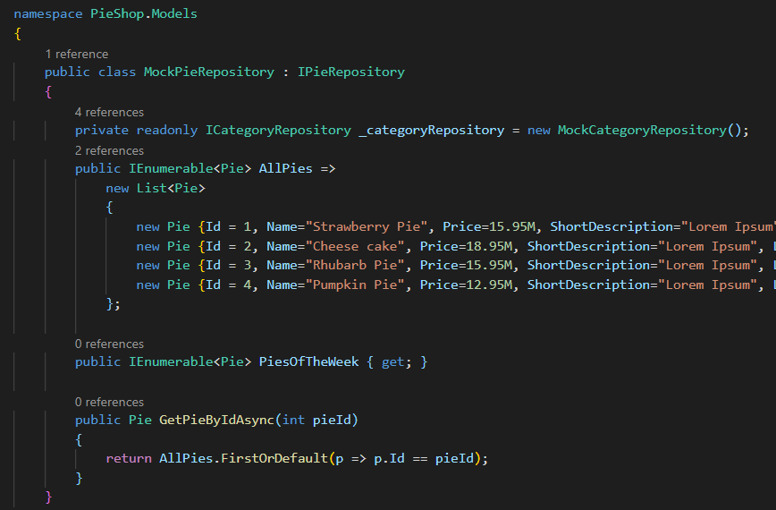
Mock Implementation
Notes:
Coming up

Slide 13
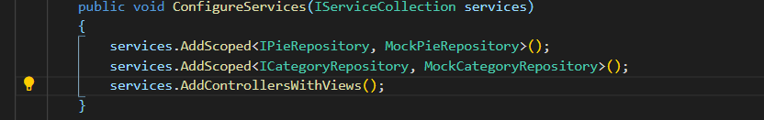
Registering Services in ConfigureServices
Notes:
Coming up

Slide 14
Registration Options
AddTransient
AddSingleton
AddScoped
Notes:
Coming up

Slide 15

Demo
Creating the domain
Adding the repository
Registering with the services collection
Notes:
Download Visual Studio: https://visualstudio.microsoft.com/vs/
Visual Studio Code: https://code.visualstudio.com/
Dotnet Core SDK: https://dotnet.microsoft.com/download
Actual Download: https://dotnet.microsoft.com/download/dotnet-core/3.0

Slide 16
Creating the Controller
Notes:
Coming up

Slide 17
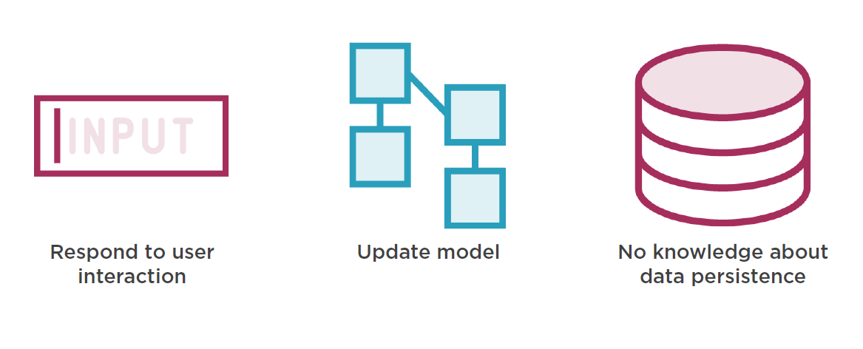
Tasks of the Controller
Notes:
Coming up

Slide 18
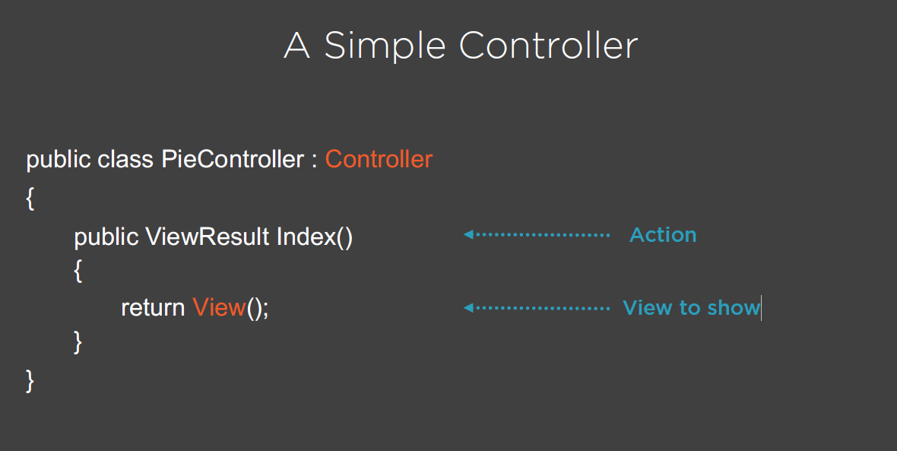
Notes:
Coming up

Slide 19
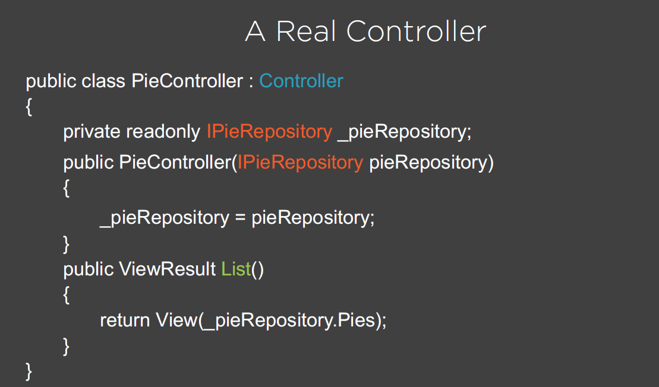
Notes:
Coming up

Slide 20
Demo
Adding the controller
Notes:
Download Visual Studio: https://visualstudio.microsoft.com/vs/
Visual Studio Code: https://code.visualstudio.com/
Dotnet Core SDK: https://dotnet.microsoft.com/download
Actual Download: https://dotnet.microsoft.com/download/dotnet-core/3.0

Slide 21
Adding the View
Notes:
Coming up

Slide 22

The Model
HTML template
- *.cshtml
“Plain” or strongly-typed
Uses Razor

Slide 23
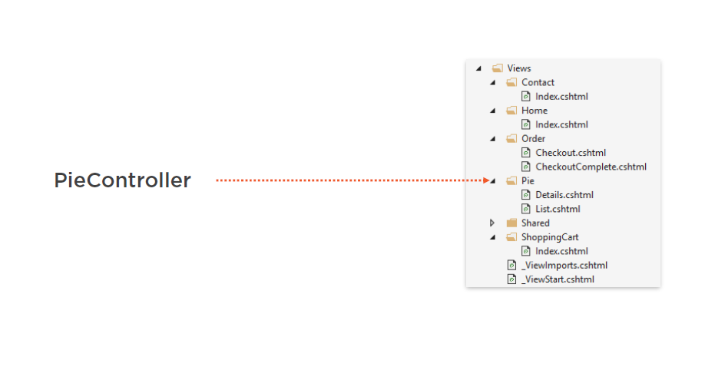
Matching the Controller and its Views
Notes:
Coming up

Slide 24
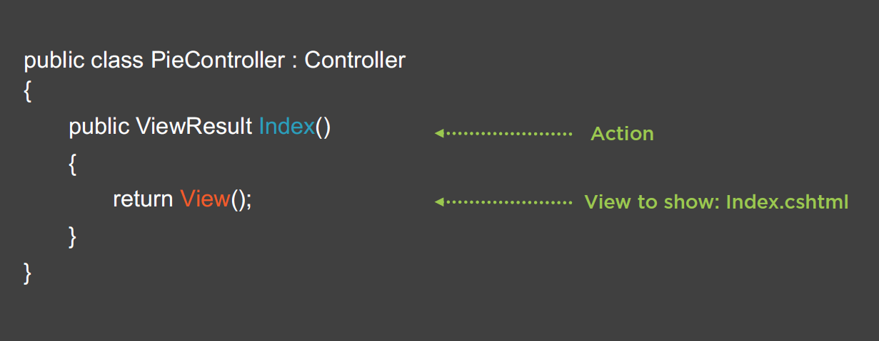
Matching the Action With the View
Notes:
Coming up

Slide 25
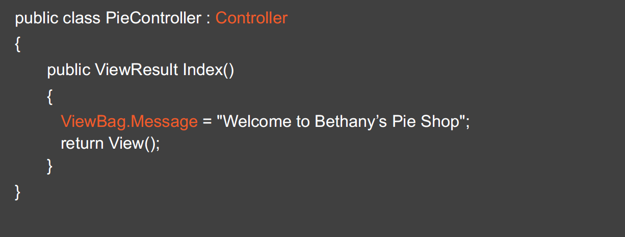
Using ViewBag from the Controller
Notes:
Coming up

Slide 26
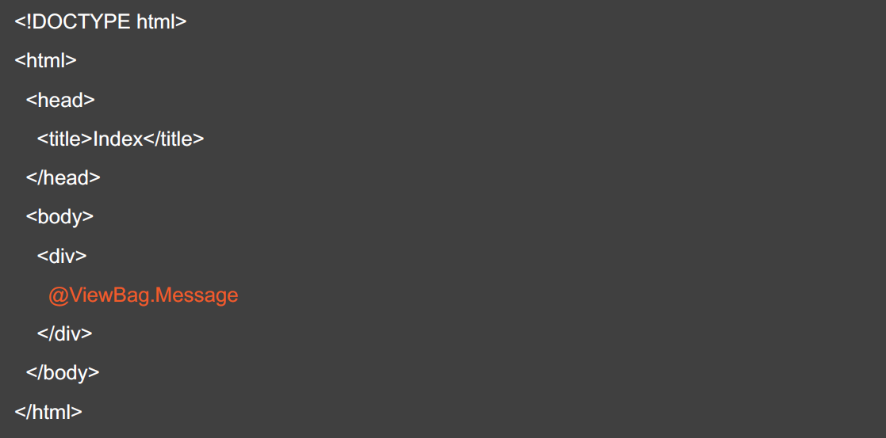
Dynamic Content Using ViewBag
Notes:
Coming up

Slide 27
Razor is a markup syntax which allows us to include C# functionality in our web pages

Slide 28
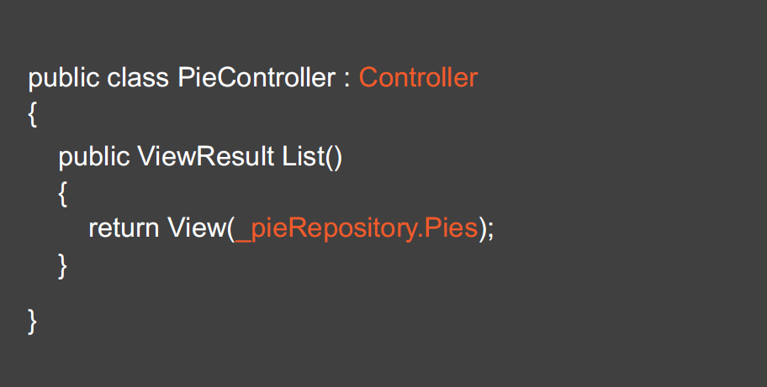
Calling a Strongly-typed View
Notes:
Coming up

Slide 29
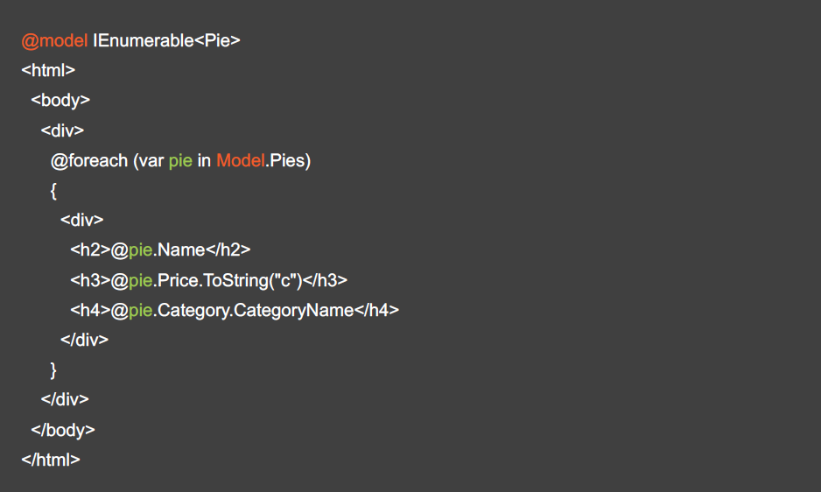
A Strongly-typed View
Notes:
Coming up

Slide 30
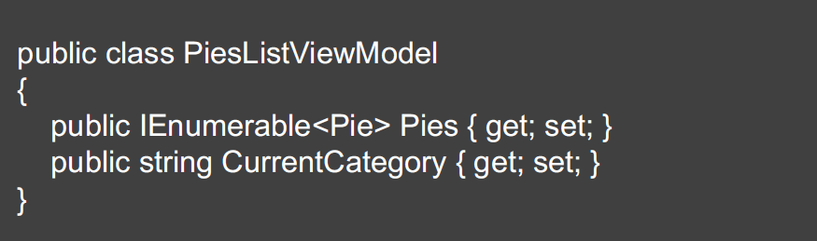
View Model
Notes:
Coming up

Slide 31
_Layout.cshtml
Template
Shared folder
More than one can be created

Slide 32
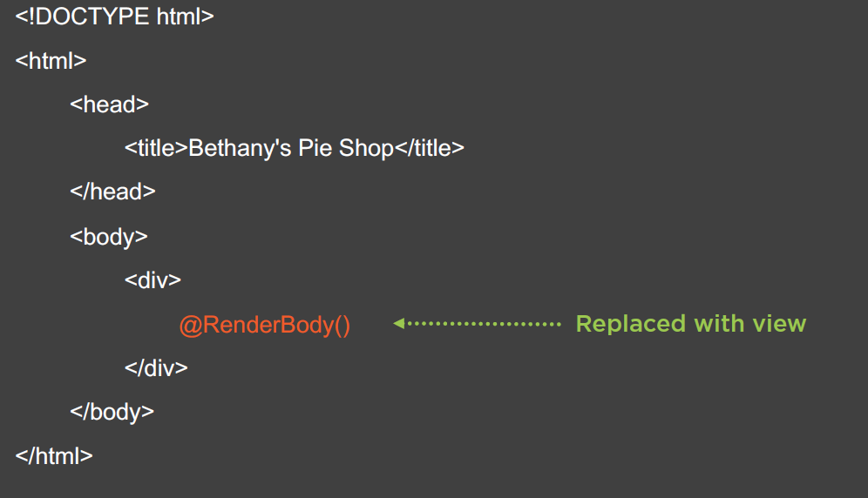
_Layout.cshtml
Notes:
Coming up

Slide 33
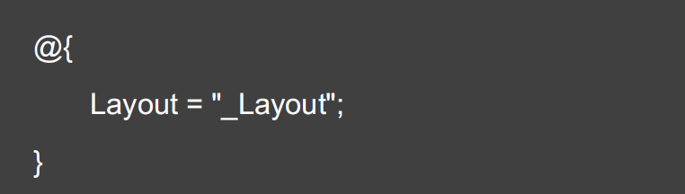
_ViewStart.cshtml
Notes:
Coming up

Slide 34
_ViewStart.cshtml
Notes:
Coming up

Slide 35
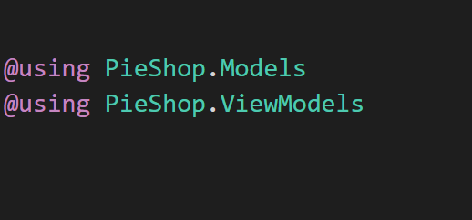
_ViewImports.cshtml
Notes:
Coming up

Slide 36
Demo
Creating the first view
Using a View Model
Notes:
Download Visual Studio: https://visualstudio.microsoft.com/vs/
Visual Studio Code: https://code.visualstudio.com/
Dotnet Core SDK: https://dotnet.microsoft.com/download
Actual Download: https://dotnet.microsoft.com/download/dotnet-core/3.0

Slide 37
Styling the View
Notes:
Coming up

Slide 38
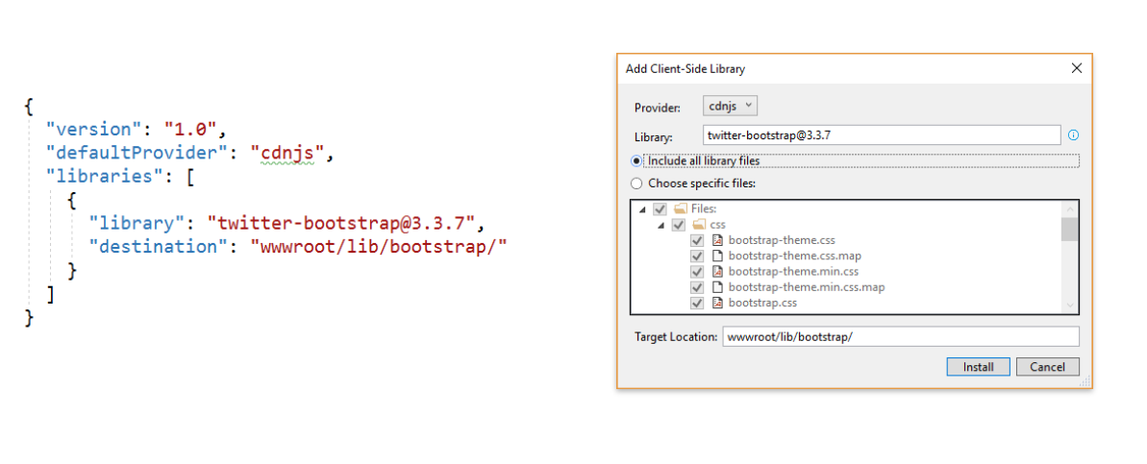
Using Library Manager (LibMan)
Notes:
Coming up

Slide 39
Demo
Adding client-side packages using
Library Manager
Add styles
Notes:
Download Visual Studio: https://visualstudio.microsoft.com/vs/
Visual Studio Code: https://code.visualstudio.com/
Dotnet Core SDK: https://dotnet.microsoft.com/download
Actual Download: https://dotnet.microsoft.com/download/dotnet-core/3.0

